Slide 1
How do you revise?

Slide 2
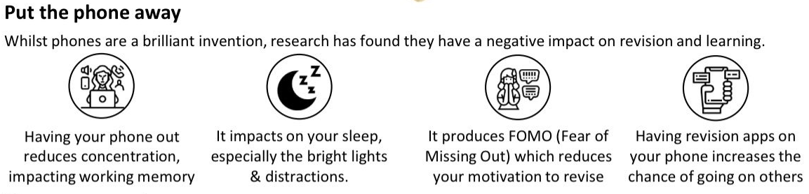

Slide 3
What are the best ways to revise?

Slide 4
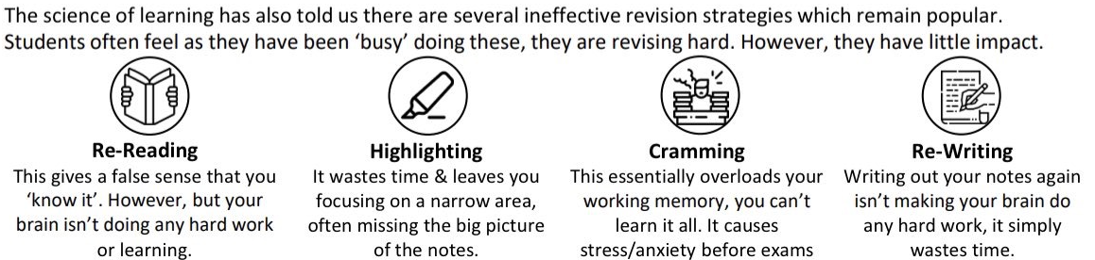
What we know does not work

Slide 5
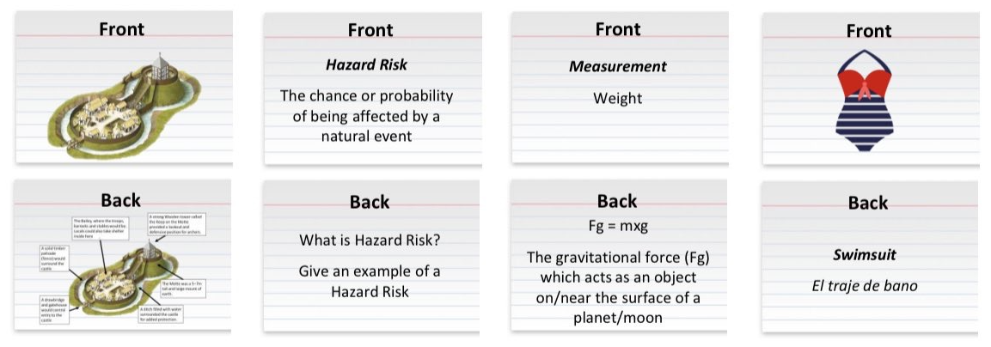
flashcards

Slide 6
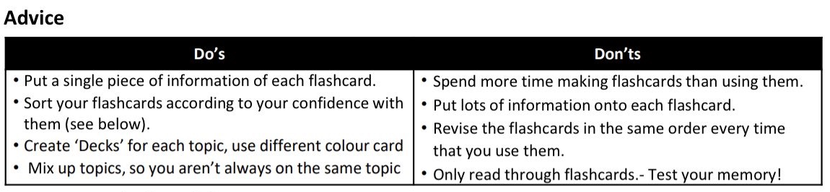
flashcards

Slide 7
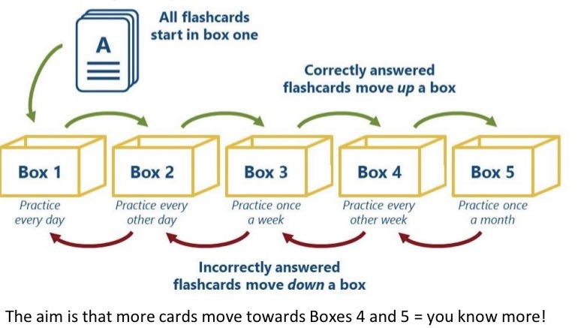
The leitner system

Slide 8
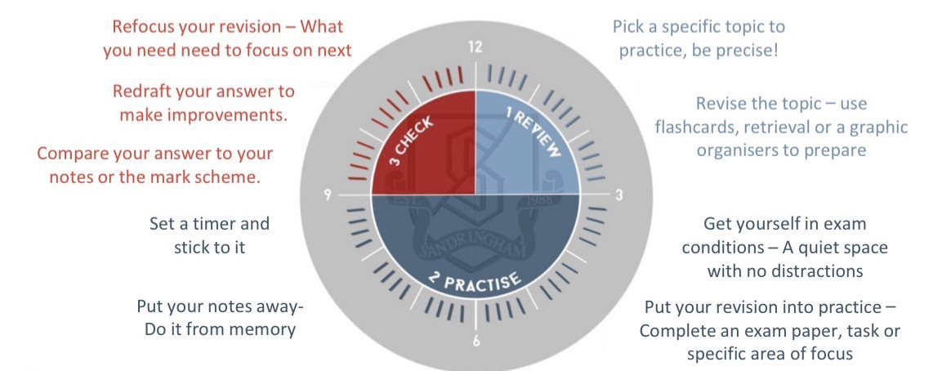
Memory clock

Slide 9
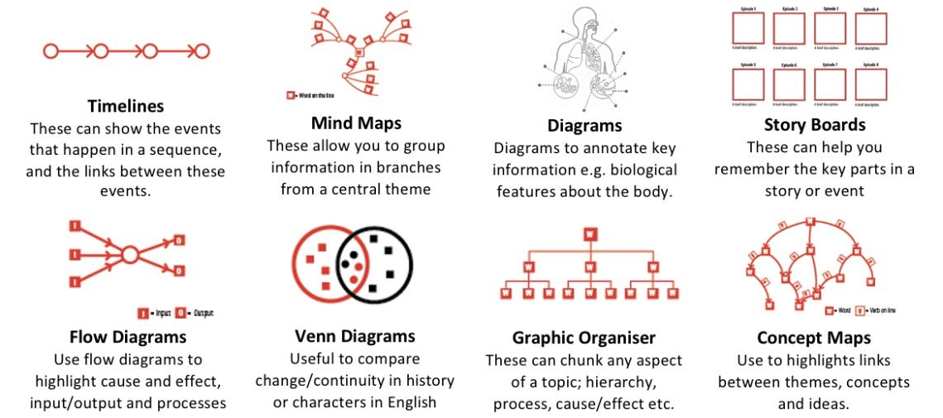
Dual coding

Slide 10
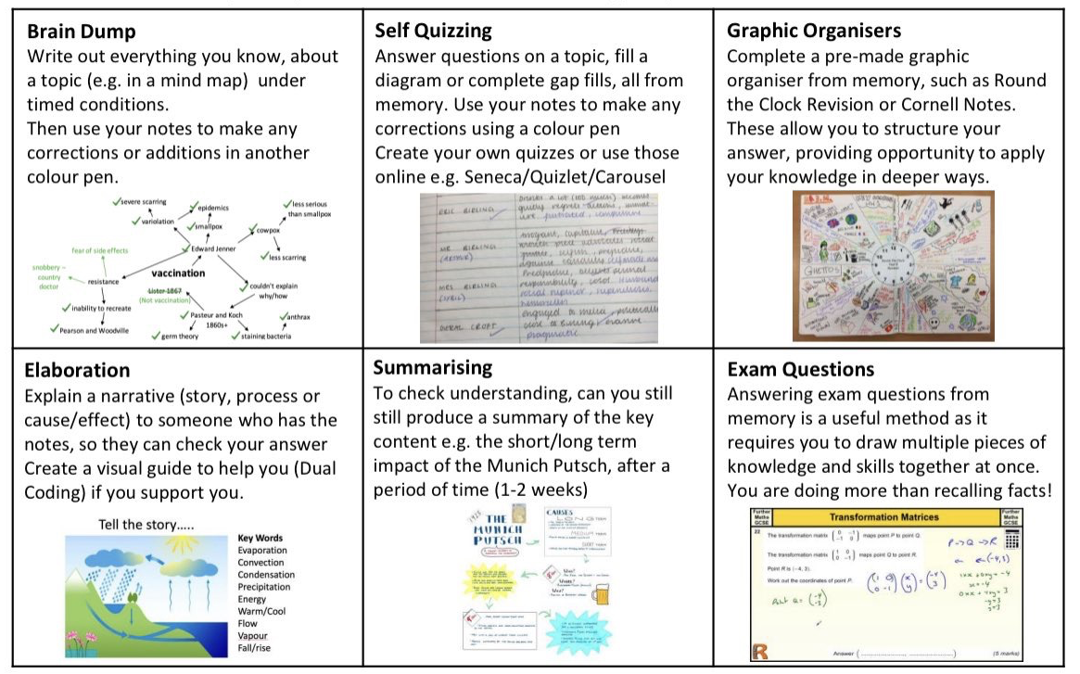
Retrieval practice

